Slide 1
Introduction to AI: Week 6 – Constraint Satisfaction Problems
Original Slides by: Tom Lenaerts
Institut de Recherches Interdisciplinaires et de Développements en Intelligence Artificielle (IRIDIA)
Université Libre de Bruxelles
Adapted for Edinburgh Napier by Ben Paechter

Slide 2
Outline
CSP?
Backtracking for CSP
Node, Arc, Path and K-Consistency
Problem structure and decomposition
Original Slides by Tom Lenaerts – IRIDIA ULB
Adapted for Edinburgh Napier by Ben Paechter

Slide 3
Constraint satisfaction problems
What is a CSP?
  Finite set of variables V₁, V₂, …, V_{n}
  Finite set of constrainsC₁, C₂, …, C_{m}
  Nonemtpy domain of possible values for each variable
  D_{V1}, D_{V2}, … D_{Vn}
  Each constraint C_{i} limits the values that variables can take, e.g., V₁ ≠ V₂
A state is defined as an assignment of values to some or all variables.
Consistent assignment: assignment does not not violate the constraints.
Original Slides by Tom Lenaerts – IRIDIA ULB
Adapted for Edinburgh Napier by Ben Paechter

Slide 4
Constraint satisfaction problems
An assignment is complete when every variable has an assigned value.
A solution to a CSP is a complete assignment that satisfies all constraints.
Some CSPs require a solution that maximizes an objective function.
Applications: Scheduling the time of observations on the Hubble Space Telescope, University Timetabling, Floor planning, Map coloring, Cryptography
Original Slides by Tom Lenaerts – IRIDIA ULB
Adapted for Edinburgh Napier by Ben Paechter

Slide 5
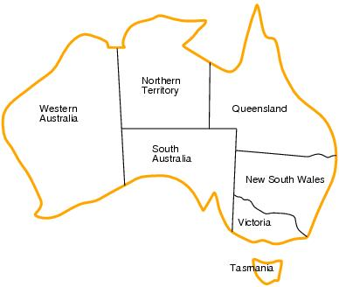
CSP example: map coloring
Variables: WA, NT, Q, NSW, V, SA, T
Domains: D_{i}={red,green,blue}
Constraints:adjacent regions must have different colors.
    E.g. WA ≠ NT (if the language allows this)
    E.g. (WA,NT) = {(red,green),(red,blue),(green,red),(green,blue),(blue, red),(blue,green}
Original Slides by Tom Lenaerts – IRIDIA ULB
Adapted for Edinburgh Napier by Ben Paechter

Slide 6
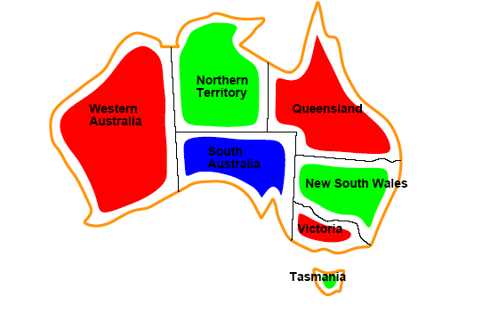
CSP example: map coloring
Solutions are assignments satisfying all constraints, e.g.
{WA=red,NT=green,Q=red,NSW=green,V=red,SA=blue,T=green}
Original Slides by Tom Lenaerts – IRIDIA ULB
Adapted for Edinburgh Napier by Ben Paechter

Slide 7
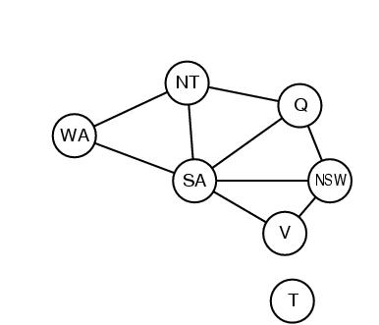
Constraint graph
CSP benefits
  Standard representation pattern
  Generic goal and successor functions
  Generic heuristics (no domain specific expertise).
Constraint graph = nodes are variables, edges show constraints.
  Graph can be used to simplify search.
    e.g. Tasmania is an independent subproblem.
Original Slides by Tom Lenaerts – IRIDIA ULB
Adapted for Edinburgh Napier by Ben Paechter

Slide 8
Varieties of CSPs
Discrete variables
  Finite domains; size d ⇒O(d^{n}) complete assignments.
  Infinite domains (integers, strings, etc.)
    E.g. job scheduling, variables are start/end days for each job
    Need a constraint language e.g StartJob₁ +5 ≤ StartJob₃.
Continuous variables
  e.g. start/end times for Hubble Telescope observations.
Original Slides by Tom Lenaerts – IRIDIA ULB
Adapted for Edinburgh Napier by Ben Paechter

Slide 9
Varieties of constraints
Unary constraints involve a single variable.
  e.g. SA ≠ green, Ben cannot teach on Fridays
Binary constraints involve pairs of variables.
  e.g. SA ≠ WA, Intro to AI and Emergent Computing cannot take place a the same time
Higher-order constraints involve 3 or more variables.
  e.g. Ben’s classes should not be timed so that he teaches on every day
Preference (soft constraints) e.g. red is better than green often representable by a cost for each variable assignment → constrained optimization problems.
  E.g Ben prefers not to teach after 5.00pm
Original Slides by Tom Lenaerts – IRIDIA ULB
Adapted for Edinburgh Napier by Ben Paechter

Slide 10
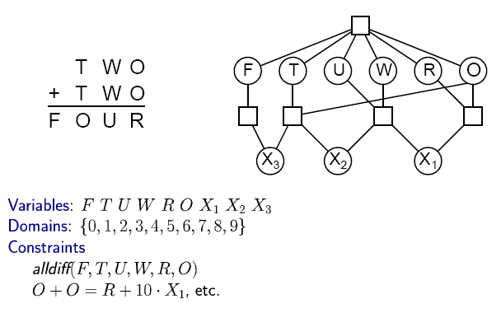

Example; cryptarithmetic
Original Slides by Tom Lenaerts – IRIDIA ULB
Adapted for Edinburgh Napier by Ben Paechter

Slide 11
CSP as a standard search problem
A CSP can easily expressed as a standard search problem
Incremental formulation
  Initial State: the empty assignment {}.
  Successor function: Assign value to unassigned variable provided that there is not conflict.
  Goal test: the current assignment is complete.
Original Slides by Tom Lenaerts – IRIDIA ULB
Adapted for Edinburgh Napier by Ben Paechter

Slide 12
CSP as a standard search problem
This is the same for all CSP’s
Solution is found at depth n (if there are n variables).
  Hence depth first search can be used.
Problem:
  Branching factor b at the top level is nd. (d is size of domain)
  b=(n-l)d at depth l, hence n!d^{n} leaves (but there are only d^{n} possible assignments).
  Solution….
Original Slides by Tom Lenaerts – IRIDIA ULB
Adapted for Edinburgh Napier by Ben Paechter

Slide 13
Commutativity
CSPs are commutative.
  The order of any given set of actions has no effect on the outcome.
  Example: choose colors for Australian territories one at a time
    [WA=red then NT=green] same as [NT=green then WA=red]
Therefore Solution: All CSP search algorithms consider a single variable assignment at a time ⇒ there are d^{n} leaves.
Original Slides by Tom Lenaerts – IRIDIA ULB
Adapted for Edinburgh Napier by Ben Paechter

Slide 14
Backtracking search
Based on Depth-first search
Chooses values for one variable at a time and backtracks when a variable has no legal values left to assign.
Uninformed algorithm
Original Slides by Tom Lenaerts – IRIDIA ULB
Adapted for Edinburgh Napier by Ben Paechter

Slide 15
Backtracking search
function BACKTRACKING-SEARCH(csp) return a solution or failure
return RECURSIVE-BACKTRACKING({} , csp)
function RECURSIVE-BACKTRACKING(assignment, csp) return a solution or failure
if assignment is complete then return assignment
var ← SELECT-UNASSIGNED-VARIABLE(VARIABLES[csp],assignment,csp)
for each value in ORDER-DOMAIN-VALUES(var, assignment, csp) do
if value is consistent with assignment according to CONSTRAINTS[csp] then
add {var=value} to assignment
result ← RRECURSIVE-BACTRACKING(assignment, csp)
if result ≠ failure then return result
remove {var=value} from assignment
return failure
Original Slides by Tom Lenaerts – IRIDIA ULB
Adapted for Edinburgh Napier by Ben Paechter

Slide 16

Backtracking example
Original Slides by Tom Lenaerts – IRIDIA ULB
Adapted for Edinburgh Napier by Ben Paechter

Slide 17
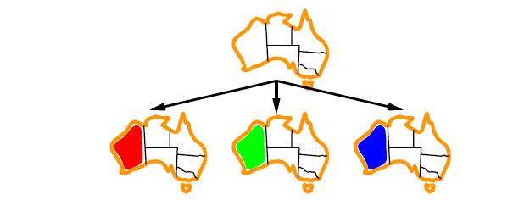
Backtracking example
Original Slides by Tom Lenaerts – IRIDIA ULB
Adapted for Edinburgh Napier by Ben Paechter

Slide 18
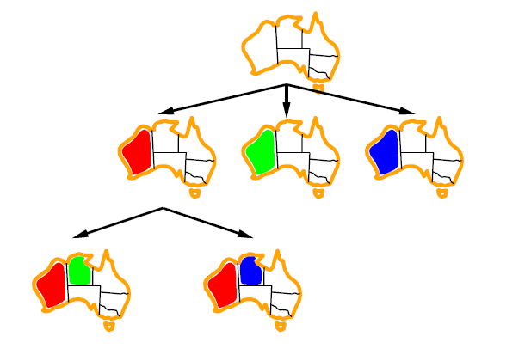
Backtracking example
Original Slides by Tom Lenaerts – IRIDIA ULB
Adapted for Edinburgh Napier by Ben Paechter

Slide 19
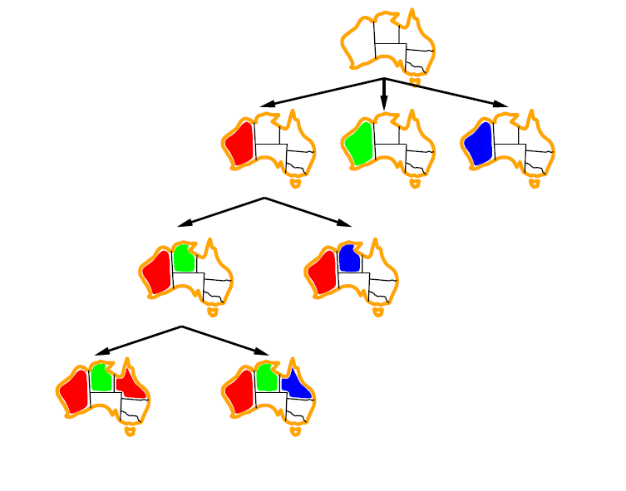
Backtracking example
Original Slides by Tom Lenaerts – IRIDIA ULB
Adapted for Edinburgh Napier by Ben Paechter

Slide 20
Example: 4-Queens Problem
X1
{1,2,3,4}
X2
{1,2,3,4}
1
2
3
4
1
2
3
4
X3
{1,2,3,4}
X4
{1,2,3,4}
[4-Queens slides copied from B.J. Dorr CMSC 421 course on AI]
Original Slides by Tom Lenaerts – IRIDIA ULB
Adapted for Edinburgh Napier by Ben Paechter

Slide 21
Example: 4-Queens Problem
X1
{1,2,3,4}
X2
{1,2,3,4}
1
2
3
4
1
2
3
4
X3
{1,2,3,4}
X4
{1,2,3,4}
Original Slides by Tom Lenaerts – IRIDIA ULB
Adapted for Edinburgh Napier by Ben Paechter

Slide 22
Example: 4-Queens Problem
X1
{1,2,3,4}
X2
{ , ,3,4}
1
2
3
4
1
2
3
4
X3
{ ,2, ,4}
X4
{ ,2,3, }
Original Slides by Tom Lenaerts – IRIDIA ULB
Adapted for Edinburgh Napier by Ben Paechter

Slide 23
Example: 4-Queens Problem
X1
{1,2,3,4}
X2
{ , ,3,4}
1
2
3
4
1
2
3
4
X3
{ ,2, ,4}
X4
{ ,2,3, }
Original Slides by Tom Lenaerts – IRIDIA ULB
Adapted for Edinburgh Napier by Ben Paechter

Slide 24
Example: 4-Queens Problem
X1
{1,2,3,4}
X2
{ , ,3,4}
1
2
3
4
1
2
3
4
X3
{ , , , }
X4
{ ,2, , }
Original Slides by Tom Lenaerts – IRIDIA ULB
Adapted for Edinburgh Napier by Ben Paechter

Slide 25
Example: 4-Queens Problem
X1
{1,2,3,4}
X2
{ , ,3,4}
1
2
3
4
1
2
3
4
X3
{ ,2, ,4}
X4
{ ,2,3, }
Original Slides by Tom Lenaerts – IRIDIA ULB
Adapted for Edinburgh Napier by Ben Paechter

Slide 26
Example: 4-Queens Problem
X1
{1,2,3,4}
X2
{ , , ,4}
1
2
3
4
1
2
3
4
X3
{ ,2, , 4}
X4
{ , 2,3, }
Original Slides by Tom Lenaerts – IRIDIA ULB
Adapted for Edinburgh Napier by Ben Paechter

Slide 27
Example: 4-Queens Problem
X1
{1,2,3,4}
X2
{ , , ,4}
1
2
3
4
1
2
3
4
X3
{ ,2, , }
X4
{ , ,3, }
Original Slides by Tom Lenaerts – IRIDIA ULB
Adapted for Edinburgh Napier by Ben Paechter

Slide 28
Example: 4-Queens Problem
X1
{1,2,3,4}
X2
{ , ,3,4}
1
2
3
4
1
2
3
4
X3
{ ,2, , }
X4
{ , ,3, }
Original Slides by Tom Lenaerts – IRIDIA ULB
Adapted for Edinburgh Napier by Ben Paechter

Slide 29
Example: 4-Queens Problem
X1
{1,2,3,4}
X2
{ , ,3,4}
1
2
3
4
1
2
3
4
X3
{ ,2, , }
X4
{ , , , }
Original Slides by Tom Lenaerts – IRIDIA ULB
Adapted for Edinburgh Napier by Ben Paechter

Slide 30
Example: 4-Queens Problem
X1
{ ,2,3,4}
X2
{1,2,3,4}
1
2
3
4
1
2
3
4
X3
{1,2,3,4}
X4
{1,2,3,4}
Original Slides by Tom Lenaerts – IRIDIA ULB
Adapted for Edinburgh Napier by Ben Paechter

Slide 31
Example: 4-Queens Problem
X1
{ ,2,3,4}
X2
{ , , ,4}
1
2
3
4
1
2
3
4
X3
{1, ,3, }
X4
{1, ,3,4}
Original Slides by Tom Lenaerts – IRIDIA ULB
Adapted for Edinburgh Napier by Ben Paechter

Slide 32
Example: 4-Queens Problem
X1
{ ,2,3,4}
X2
{ , , ,4}
1
2
3
4
1
2
3
4
X3
{1, ,3, }
X4
{1, ,3,4}
Original Slides by Tom Lenaerts – IRIDIA ULB
Adapted for Edinburgh Napier by Ben Paechter

Slide 33
Example: 4-Queens Problem
X1
{ ,2,3,4}
X2
{ , , ,4}
1
2
3
4
1
2
3
4
X3
{1, , , }
X4
{1, ,3, }
Original Slides by Tom Lenaerts – IRIDIA ULB
Adapted for Edinburgh Napier by Ben Paechter

Slide 34
Example: 4-Queens Problem
X1
{ ,2,3,4}
X2
{ , , ,4}
1
2
3
4
1
2
3
4
X3
{1, , , }
X4
{1, ,3, }
Original Slides by Tom Lenaerts – IRIDIA ULB
Adapted for Edinburgh Napier by Ben Paechter

Slide 35
Example: 4-Queens Problem
X1
{ ,2,3,4}
X2
{ , , ,4}
1
2
3
4
1
2
3
4
X3
{1, , , }
X4
{ , ,3, }
Original Slides by Tom Lenaerts – IRIDIA ULB
Adapted for Edinburgh Napier by Ben Paechter

Slide 36
Example: 4-Queens Problem
X1
{ ,2,3,4}
X2
{ , , ,4}
1
2
3
4
1
2
3
4
X3
{1, , , }
X4
{ , ,3, }
Original Slides by Tom Lenaerts – IRIDIA ULB
Adapted for Edinburgh Napier by Ben Paechter

Slide 37
Improving backtracking efficiency
Introduce heuristics
General-purpose methods can give huge gains in speed:
  Which variable should be assigned next?
  In what order should its values be tried?
  Can we detect inevitable failure early?
  Can we take advantage of problem structure?
Original Slides by Tom Lenaerts – IRIDIA ULB
Adapted for Edinburgh Napier by Ben Paechter

Slide 38
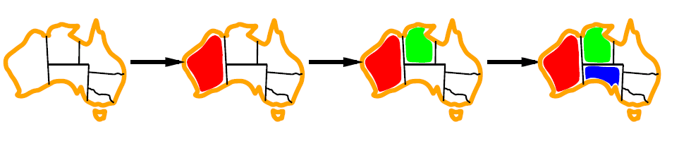
Minimum remaining values
var ← SELECT-UNASSIGNED-VARIABLE(VARIABLES[csp],assignment,csp)
A.k.a. most constrained variable heuristic
Which variable shall we try first?
Rule: choose variable with the fewest legal moves
Original Slides by Tom Lenaerts – IRIDIA ULB
Adapted for Edinburgh Napier by Ben Paechter

Slide 39

Degree heuristic
Rule: select variable that is involved in the largest number of constraints on other unassigned variables.
In practice degree heuristic is very useful as a tie breaker of MRV.
Having chosen a variable - In what order should its values be tried?
Original Slides by Tom Lenaerts – IRIDIA ULB
Adapted for Edinburgh Napier by Ben Paechter

Slide 40
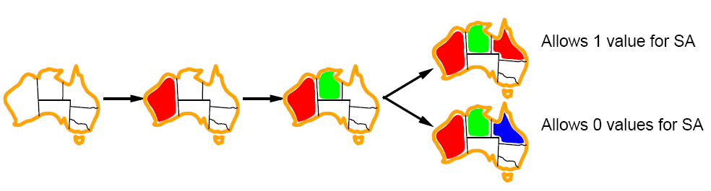
Least constraining value
Least constraining value heuristic
Rule: given a variable choose the least constraing value i.e. the one that leaves the maximum flexibility for subsequent variable assignments.
Original Slides by Tom Lenaerts – IRIDIA ULB
Adapted for Edinburgh Napier by Ben Paechter

Slide 41
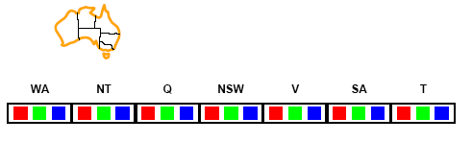
Forward checking
Can we detect inevitable failure early?
  And avoid it later?
Forward checking idea: keep track of remaining legal values for unassigned variables.
Terminate search when any variable has no legal values.
Original Slides by Tom Lenaerts – IRIDIA ULB
Adapted for Edinburgh Napier by Ben Paechter

Slide 42
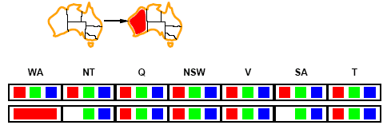
Forward checking
Assign {WA=red}
Effects on other variables connected by constraints with WA
  NT can no longer be red
  SA can no longer be red
Original Slides by Tom Lenaerts – IRIDIA ULB
Adapted for Edinburgh Napier by Ben Paechter

Slide 43
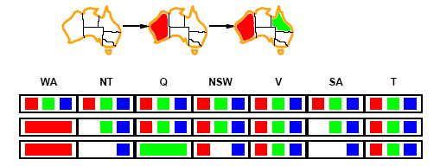
Forward checking
Assign {Q=green}
Effects on other variables connected by constraints with WA
  NT can no longer be green
  NSW can no longer be green
  SA can no longer be green
Original Slides by Tom Lenaerts – IRIDIA ULB
Adapted for Edinburgh Napier by Ben Paechter

Slide 44
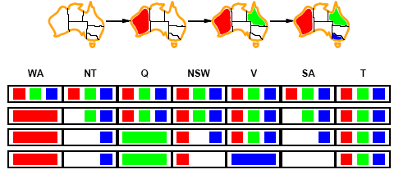
Forward checking
If V is assigned blue
Effects on other variables connected by constraints with WA
  SA is empty
  NSW can no longer be blue
FC has detected that partial assignment is inconsistent with the constraints and backtracking can occur.
Original Slides by Tom Lenaerts – IRIDIA ULB
Adapted for Edinburgh Napier by Ben Paechter

Slide 45
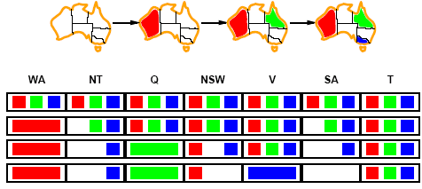
Constraint propagation
Solving CSPs with combination of heuristics plus forward checking is more efficient than either approach alone.
FC checking propagates information from assigned to unassigned variables but does not provide detection for all failures.
  NT and SA cannot be blue!
Constraint propagation repeatedly enforces constraints locally
Original Slides by Tom Lenaerts – IRIDIA ULB
Adapted for Edinburgh Napier by Ben Paechter

Slide 46
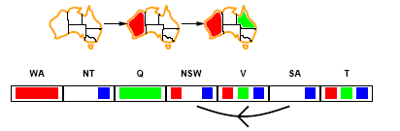
Arc consistency
X → Y is consistent iff
for every value x of X there is some allowed y
SA → NSW is consistent iff
SA=blue and NSW=red
Original Slides by Tom Lenaerts – IRIDIA ULB
Adapted for Edinburgh Napier by Ben Paechter

Slide 47
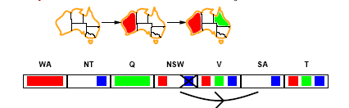
Arc consistency
X → Y is consistent iff
for every value x of X there is some allowed y
NSW → SA is consistent iff
NSW=red and SA=blue
NSW=blue and SA=???
Arc can be made consistent by removing blue from NSW
Original Slides by Tom Lenaerts – IRIDIA ULB
Adapted for Edinburgh Napier by Ben Paechter

Slide 48
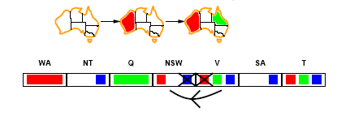
Arc consistency
Arc can be made consistent by removing blue from NSW
RECHECK neighbours
  Now remove red from V
Original Slides by Tom Lenaerts – IRIDIA ULB
Adapted for Edinburgh Napier by Ben Paechter

Slide 49
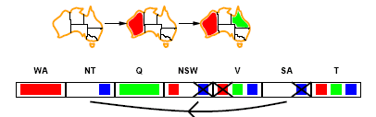
Arc consistency
Arc can be made consistent by removing blue from NSW
RECHECK neighbours !!
  Remove red from V
Arc consistency detects failure earlier than FC
Can be run as a preprocessor or after each assignment.
  Repeated until no inconsistency remains
Original Slides by Tom Lenaerts – IRIDIA ULB
Adapted for Edinburgh Napier by Ben Paechter

Slide 50
K-consistency
Arc consistency does not detect all inconsistencies:
  Partial assignment {WA=red, NSW=red} is inconsistent.
Stronger forms of propagation can be defined using the notion of k-consistency.
A CSP is k-consistent if for any set of k-1 variables and for any consistent assignment to those variables, a consistent value can always be assigned to any kth variable.
  E.g. 1-consistency or node-consistency
  E.g. 2-consistency or arc-consistency
  E.g. 3-consistency or path-consistency
Original Slides by Tom Lenaerts – IRIDIA ULB
Adapted for Edinburgh Napier by Ben Paechter

Slide 51
K-consistency
A graph is strongly k-consistent if
  It is k-consistent and
  Is also (k-1) consistent, (k-2) consistent, … all the way down to 1-consistent.
If we have a graph which is strongly k-consistent then we can search it by selecting a value for the first variable, then the second, then the third and so on – up to the Kth variable. All will work because the graph is K-consistent.
This is ideal since a solution can be found in time O(nd) YET no free lunch: any algorithm for establishing n-consistency must take time exponential in n, in the worst case.
Balance of how much consistency to find is largely empirical.
Original Slides by Tom Lenaerts – IRIDIA ULB
Adapted for Edinburgh Napier by Ben Paechter

Slide 52
Problem structure
How can the problem structure help to find a solution quickly?
Subproblem identification is important:
  Coloring Tasmania and mainland are independent subproblems
  Identifiable as connected components of constrained graph.
Improves performance
Original Slides by Tom Lenaerts – IRIDIA ULB
Adapted for Edinburgh Napier by Ben Paechter

Slide 53
Problem structure
Suppose each sub-problem has c variables out of a total of n.
Worst case solution cost is O(n/c d^{c}), i.e. linear in n
  Instead of O(d ^{n}), exponential in n
E.g. n= 80, c= 20, d=2
  2⁸⁰ = 4 billion years at 1 million nodes/sec.
  4 * 2²⁰= .4 second at 1 million nodes/sec
Original Slides by Tom Lenaerts – IRIDIA ULB
Adapted for Edinburgh Napier by Ben Paechter

Slide 54
Summary
CSPs are a special kind of problem: states defined by values of a fixed set of variables, goal test defined by constraints on variable values
Backtracking=depth-first search with one variable assigned per node
Variable ordering and value selection heuristics help significantly
Forward checking prevents assignments that lead to failure.
Constraint propagation does additional work to constrain values and detect inconsistencies.
The CSP representation allows analysis of problem structure and decomposition of problems
Original Slides by Tom Lenaerts – IRIDIA ULB
Adapted for Edinburgh Napier by Ben Paechter

